Slide 1
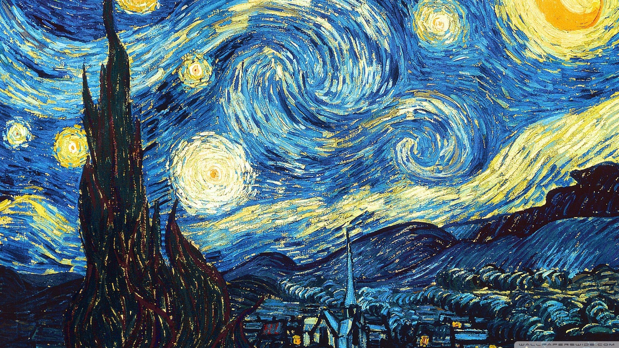
Intensity Interferometry
Arizona State University
With 10” backyard telescopes
Tom Mozdzen, Rick Scott, Phil Mauskopf
October 30, 2024

Slide 2
Background
Work at ASU on intensity interferometry started in 2012
Technology did not exist at the time
Developed CASPER ROACH-based time tagger
Started testing single photon counting detectors on telescopes
Tried Kitt Peak 90 inch – measured counts
Paper by G. Pilyavsky, 2017
Goal: Low cost, scalable interferometer with small telescopes
Status: Measured correlations with 10 inch telescopes from Sirius
SNR = 7 in 13.5 hours
Smallest aperture correlation measurement to date

Slide 3
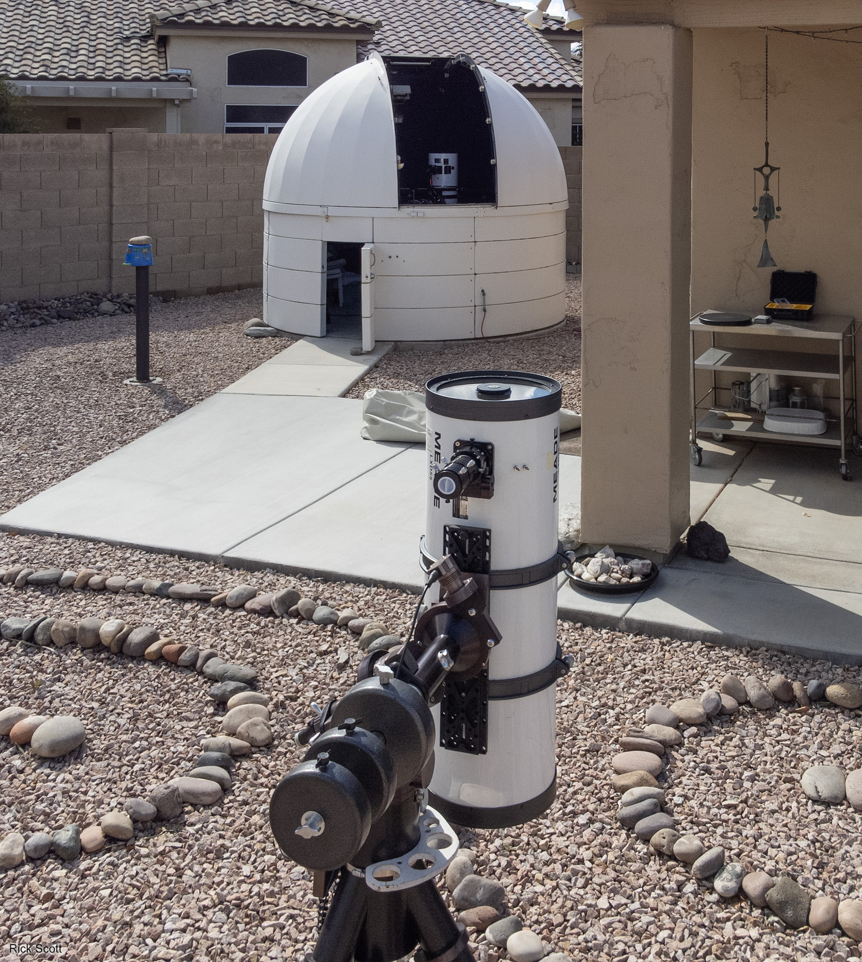
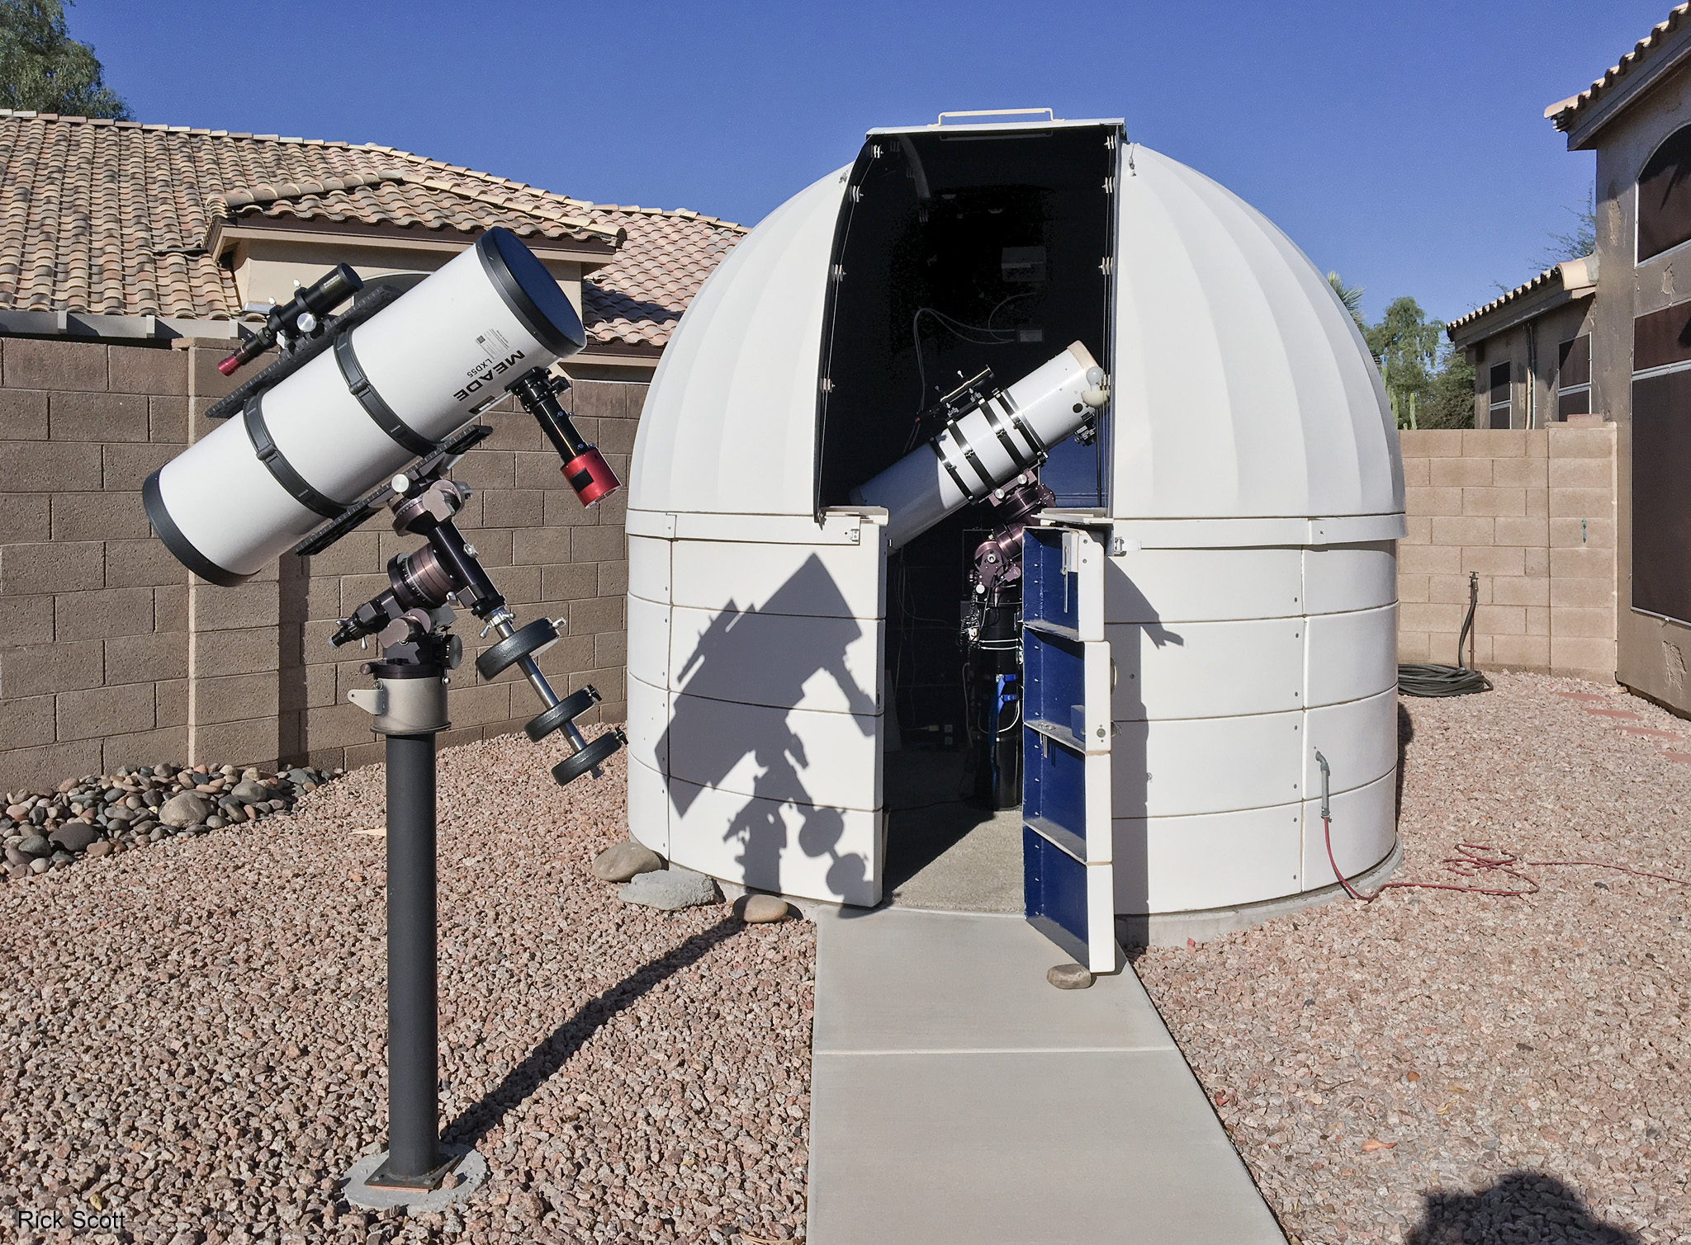
Equipment for an Intensity Interferometer
10 m Baseline
Backyard Telescopes
3.3 m Baseline
Notes:
Telescopes in our backyard set up
Telescopes
10” f/4.6 home- made Lurie-Houghton telescope
10” F/4 Meade Schmidt-Newtonian (SN10)
The SN10 replaced a 10” f/6.3 Meade Schmidt-Cassegrain (with focal reducer)
The Lurie-Houghton is in a 10’ rotating dome and is the reference scope
The Schmidt-Newtonian is mounted on external piers depending on the baseline in use
There are pier locations for 3.3 m, 10 m, and 24m baselines
The telescopes need to be guided over the course of the night to keep the star under study on the fiber optic cable to maintain a high count rate.

Slide 4
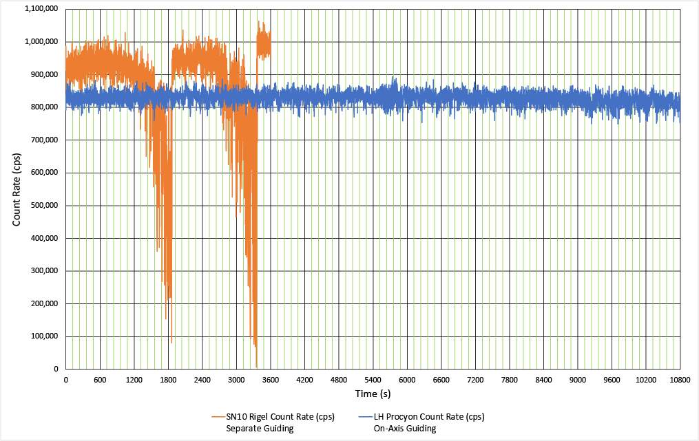
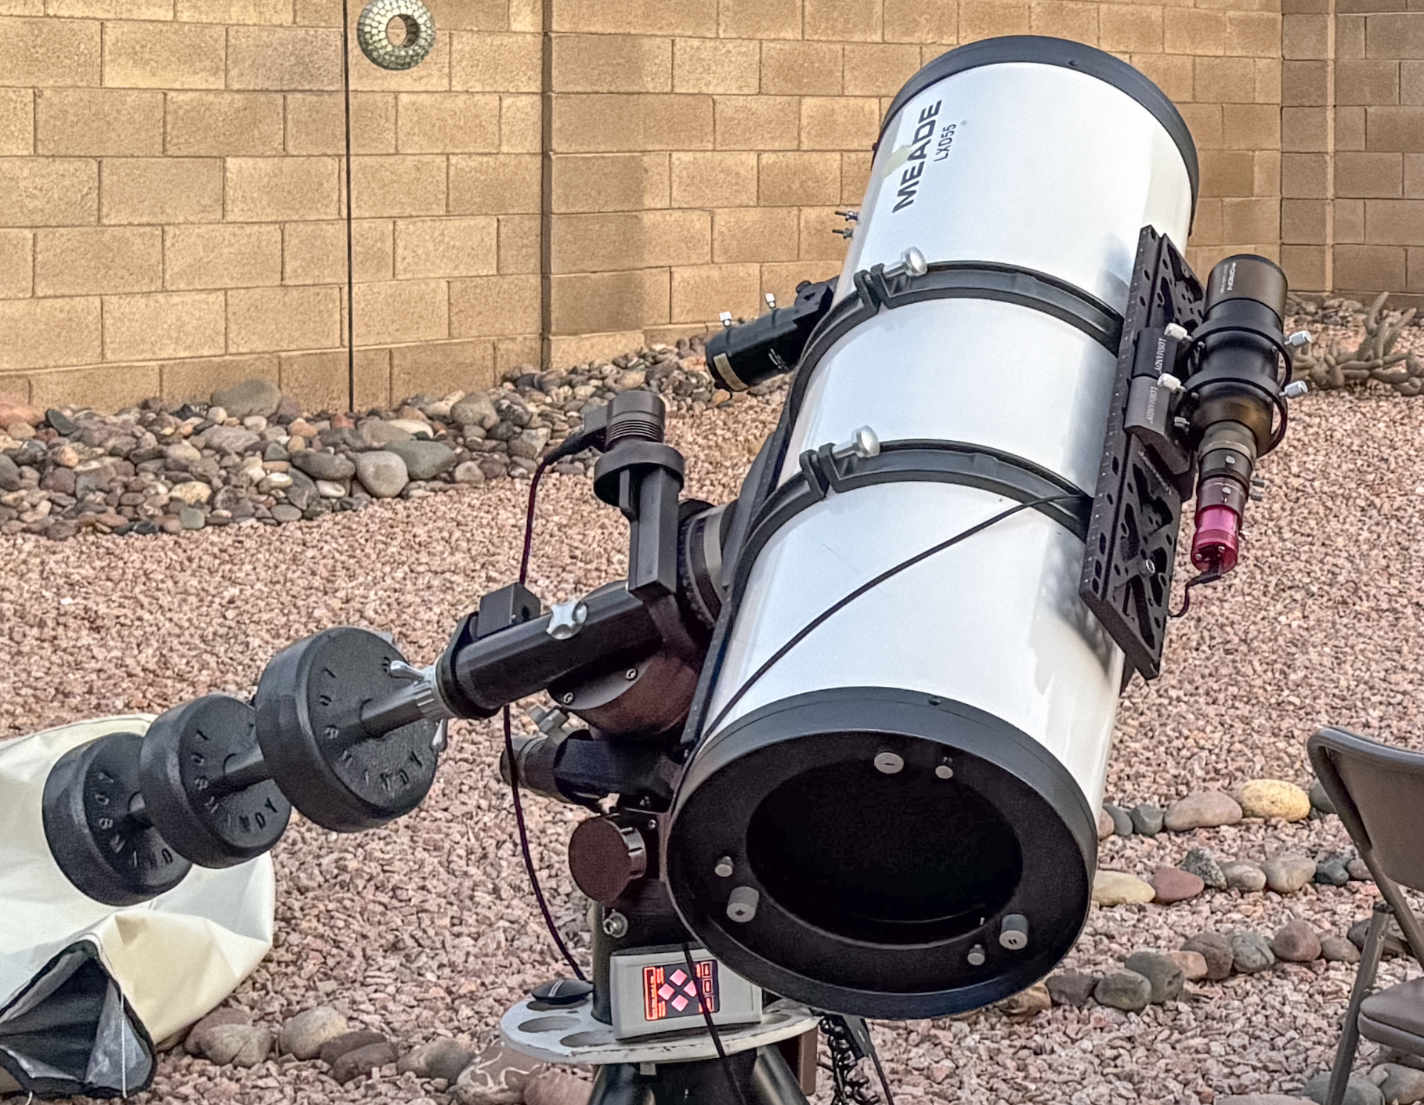
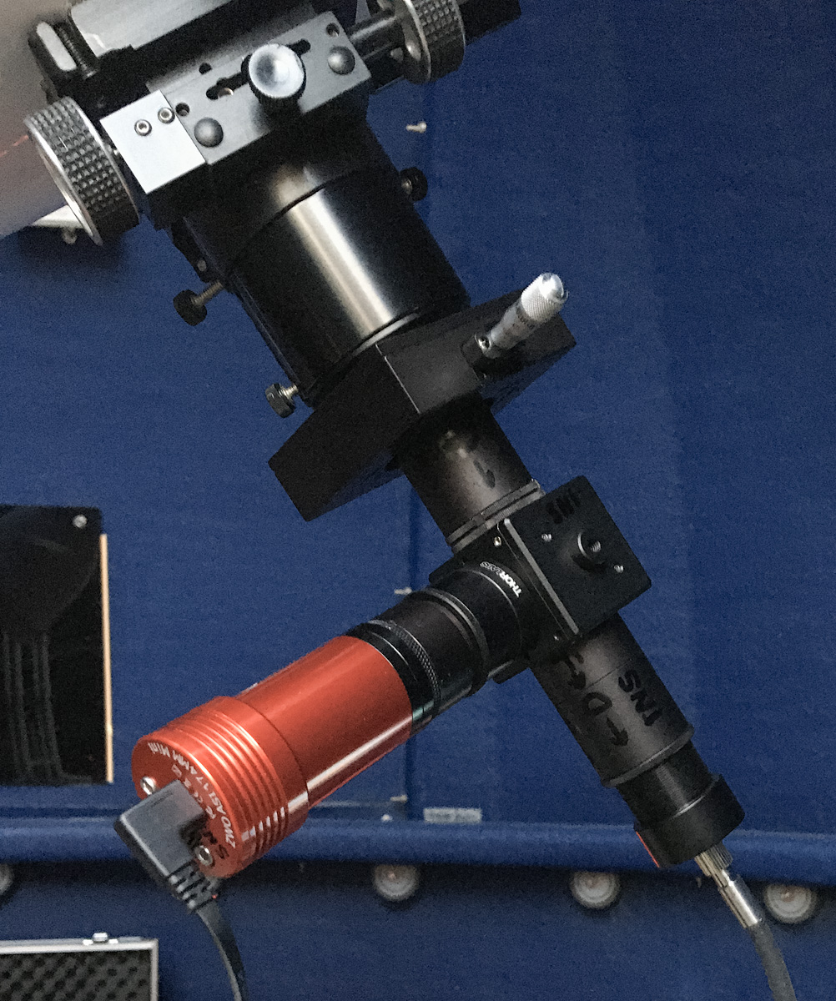
Equipment for an Intensity Interferometer
Telescope Guiding Improvement
Piggyback mounted guide scope and camera
Long-term drift due to differential flexure
Needed to reset centering every 20 to 30 minutes
Orange on the plot is 1 hour of operation
On-axis guider built into the JaZeye
No long-term drift
Can operate for hours with no recentering
Blue on the plot is 3 hours of operation

Slide 5
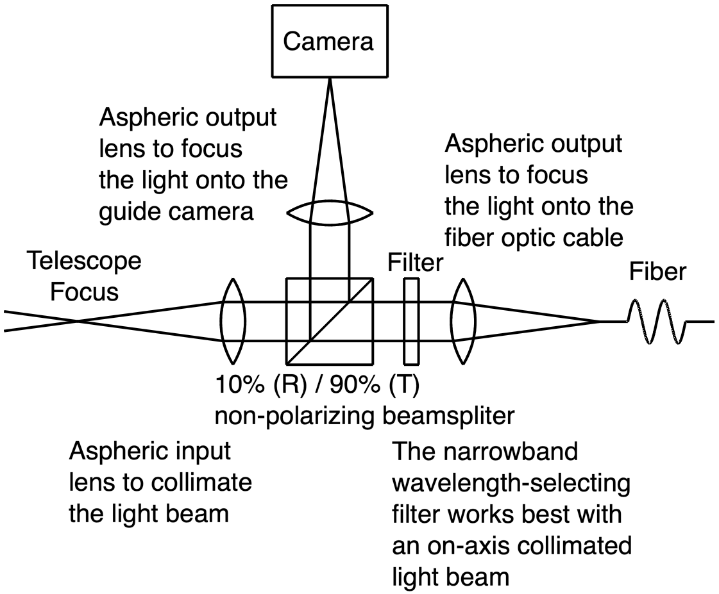
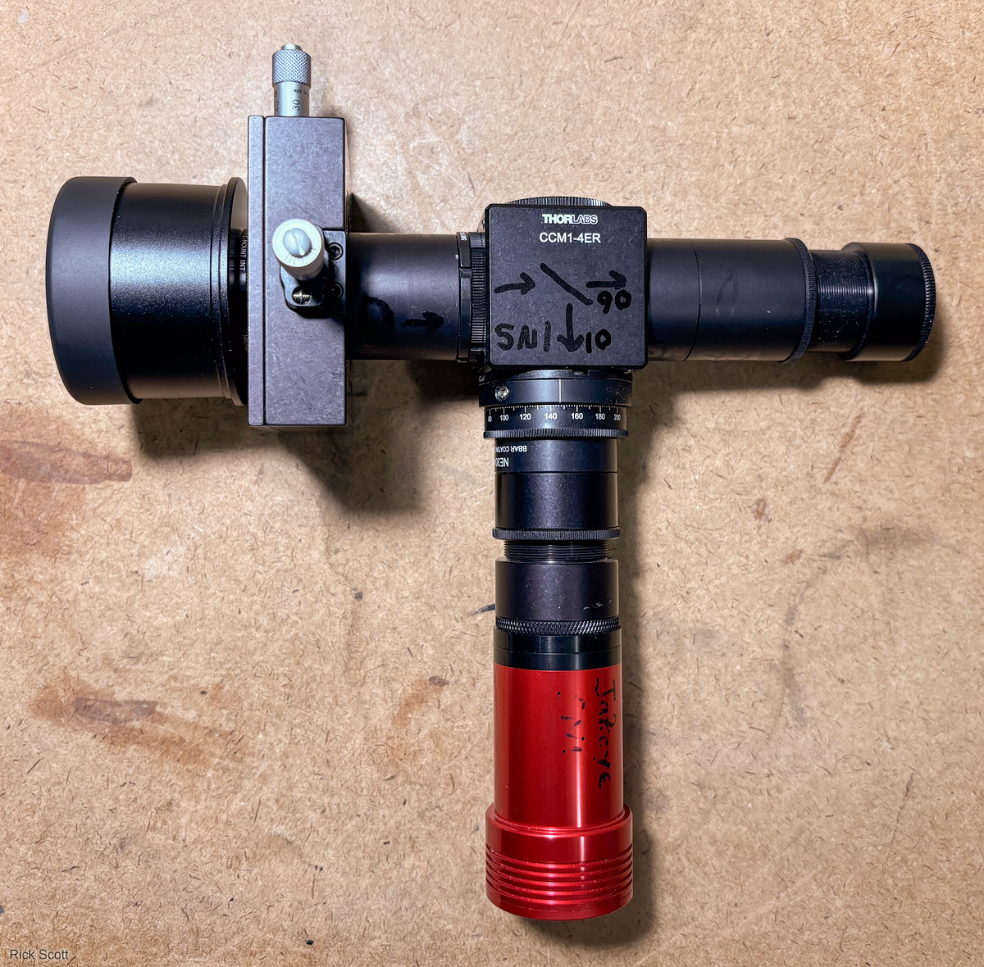
Equipment for an Intensity Interferometer
JaZeye Optical System

Slide 6
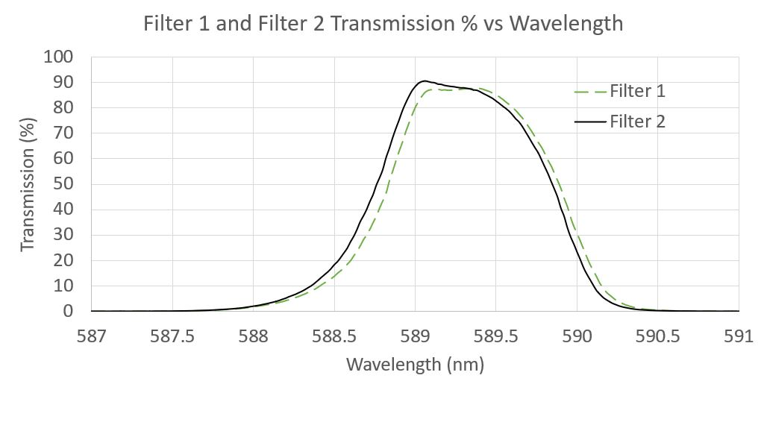
Equipment for an Intensity Interferometer
JaZeye Narrowband Filter
We measured the narrowband filters we're currently using on stars with an Agilent Cary 5000 spectrophotometer
The filters have the following characteristics:
Center wavelength = 589.25 nm
Bandwidth = 1.2 nm
Overlapping bandwidth = 1.1 nm
t_{coh} = 0.78 ps

Slide 7
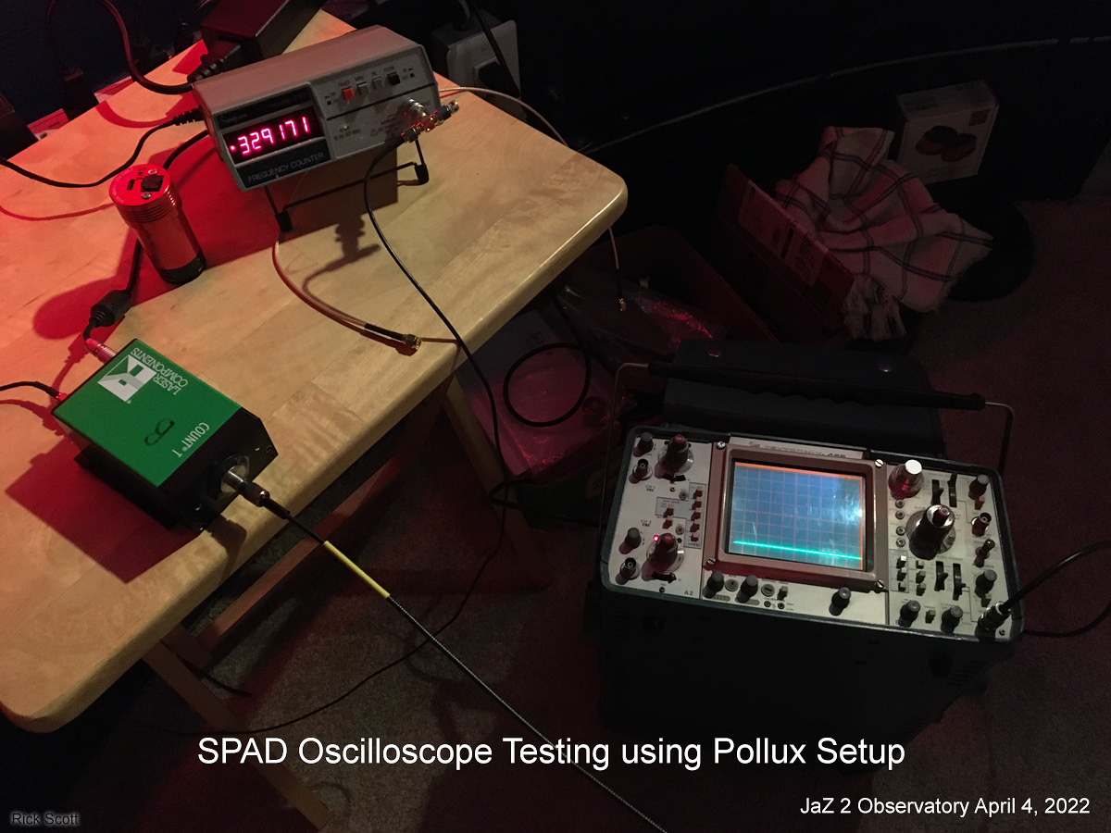
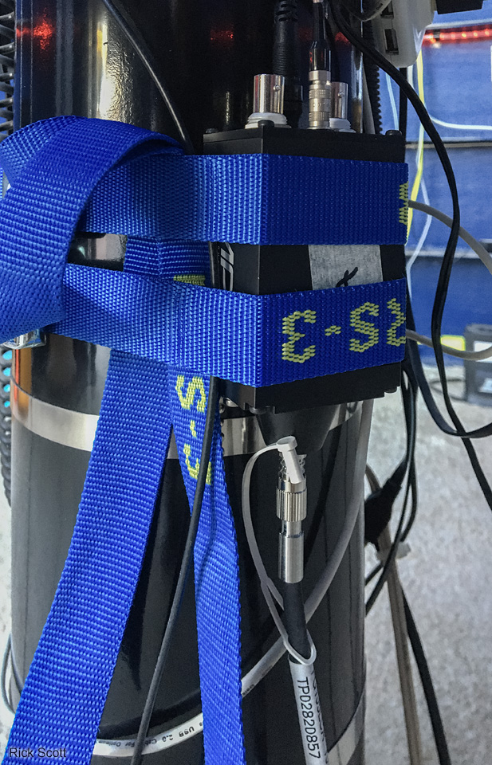
Equipment for an Intensity Interferometer
Single Photon Detectors: SPADs
Input is fed by a fiber optic cable to reduce loading on the JaZeye
Our old SPADs had a timing jitter of 350 ps vs 32 ps for our new SPADs
Old SPAD
New SPAD

Slide 8
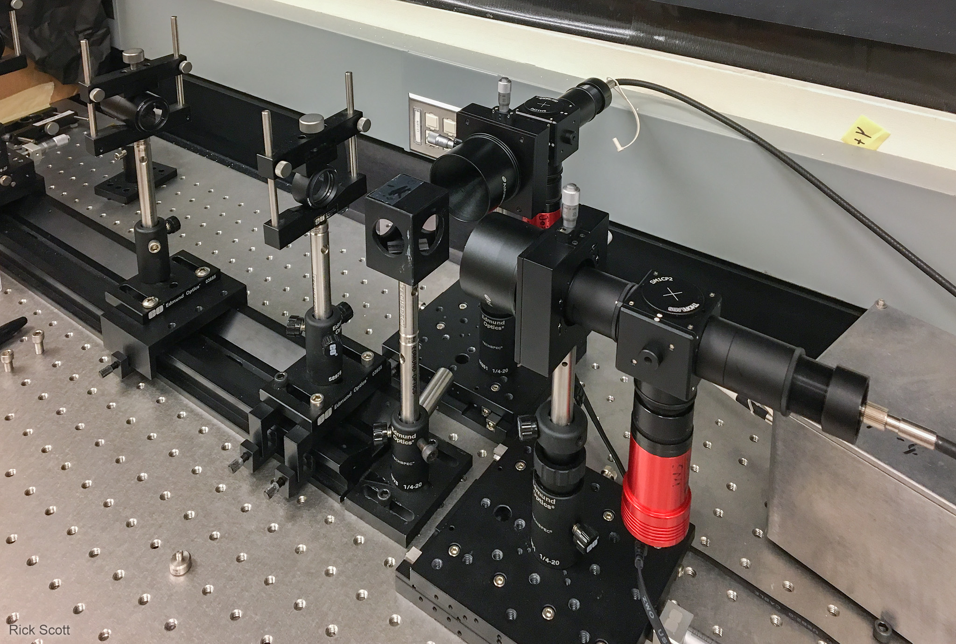
Equipment for an Intensity Interferometer
Bench Set Up
Initial testing was performed on an optical bench in the lab
The bench setup simulates a star from two telescopes
A beamsplitter is used to make a star for each JaZeye/detector system
No motion to track
No seeing effects

Slide 9
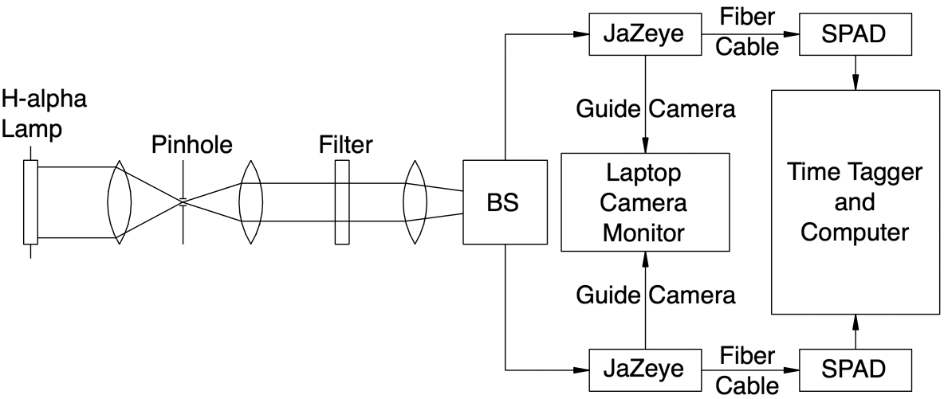
Equipment for an Intensity Interferometer
Bench Set Up Block Diagram
Components to the right of the beamsplitter is the same as on the telescopes

Slide 10
System Efficiency
Component Efficiency | Lurie-Houghton Telescope (%) | Meade SN10 Telescope (%)
Telescope Optics | 71 | 72
Jazeye Optics | 74 | 74
Fiber Optic Cable | 92 | 92
Total Optics | 49 | 49
Detector @ 589 nm | 39 | 39
Total System | 19 | 19

Slide 11
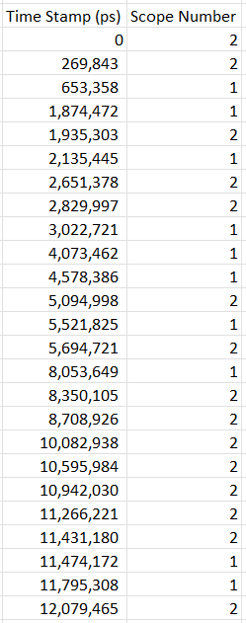
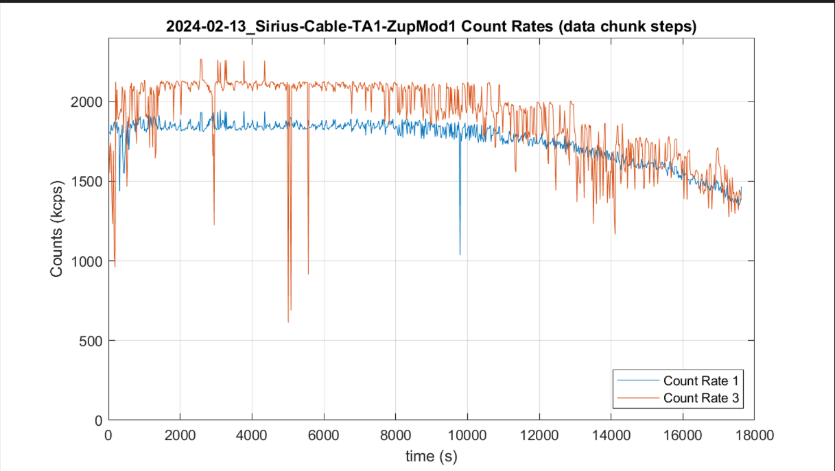
Typical Data – counts and timestamps
~20% of Photons detected
Sirius count rates are about 2 million photons per second
3 hrs of data ~ 40 billion stamps
4 bytes per event -> 160 GB
Count Rate 1
Count Rate 2
5 hrs

Slide 12
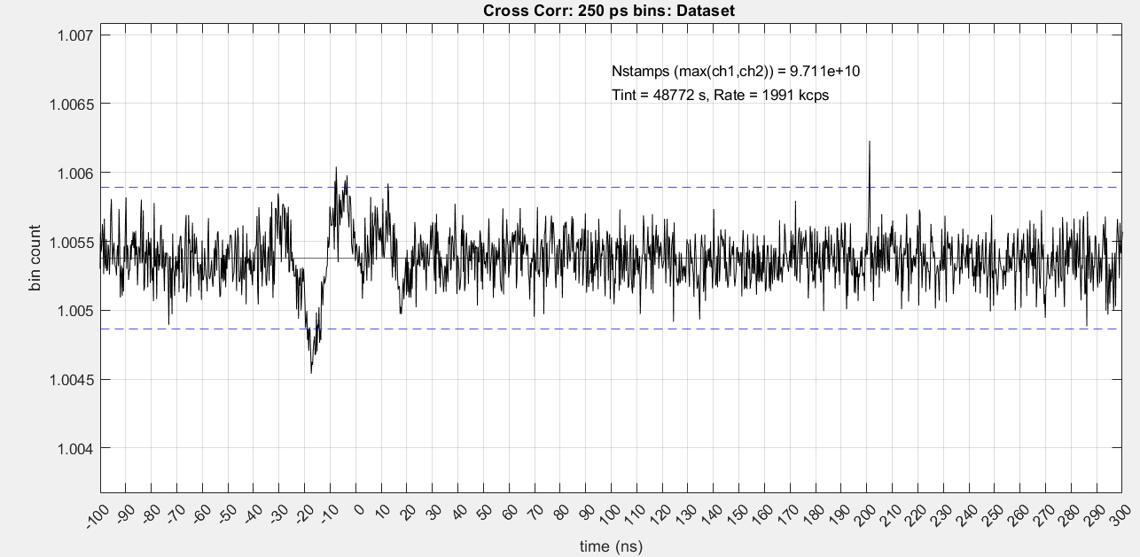
Shift the correlation away from t = 0

Slide 13
Our Favorite Equations
Integrate

Slide 14
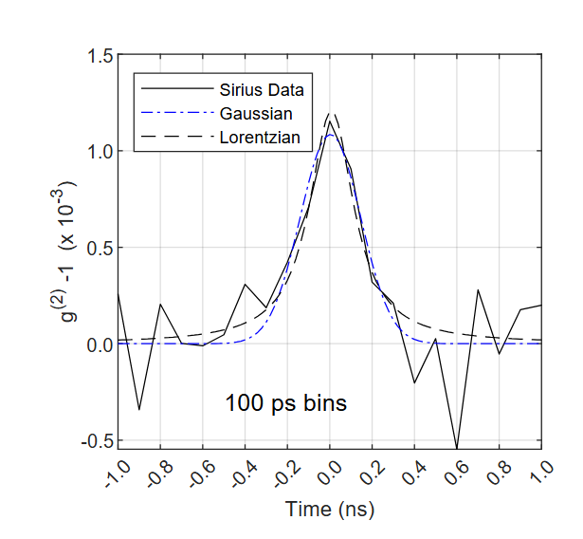
Coherence Signal

Slide 15
Gaussian Fitting Results
Source | 2x Fit Area (ps) | Fit Height (10⁻³) | Sigma Fit (ps) | τ_{res} derived (ps) | |V₁₂(3.3 m)|²
Sirius | 0.74 +/- 0.26 | 1.1 +/- 0.2 | 138 +/- 26 | 346 +/- 65 | 0.95 +/-0.33
With:
T_{coh} = 0.78 ps from the filter shape
SNR ~ 7.0
Expected |V₁₂(3.3 m)|² = 0.94 +/-0.01

Slide 16
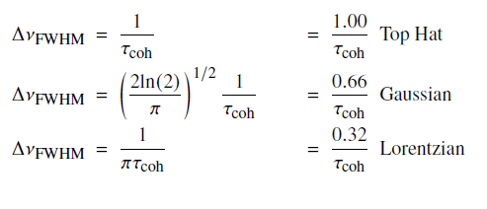
Bonus Equations

Slide 17
IV. Future Plans
Collection time reduction
More baselines simultaneously
Multiple Telescopes
Spectrometers – use multiple wavelengths to reduce collection time
Use both polarizations
Slightly larger telescope
12" to 14" would still be low cost
Lower system jitter – 6x
2.4x less collection time
Measure exotic objects
Quasars
Accretion discs around black holes

Slide 18
Questions?

Slide 19
Backup Material

Slide 20
Data Collection Sessions
Date (2024) | Start Time (MST) | Mins before Transit | Time on Sky (h) | Channel 1 Rate (Mcps) | Channel 2 Rate (Mcps) | Temp Begin to End (C)
Jan 30 | 21:13 | 84.2 | 4.25 | 1.9 | 2.0 | 16 --> 11
Feb 13 | 20:34 | 68.2 | 4.88 | 1.7 | 1.9 | 14 --> 7
Feb 14 | 20:30 | 68.3 | 4.41 | 1.8 | 2.0 | 14 --> 7
Totals |  |  | 13.55 | 1.8 | 2.0

Slide 21
Binning Statistics
Statistic | 25 ps | 50 ps | 100 ps | 200 ps
Mean (10⁷) | 0.443 | 0.887 | 1.77 | 3.55
σ_{STD} (10³) | 2.13 | 3.02 | 4.18 | 5.76
σ_{Poisson} (10³) | 2.10 | 2.97 | 4.20 | 5.94
Peak/σ_{Poisson} | 3.60 | 3.92 | 4.94 | 6.26
Fit τ_{res} (ps) | 326 | 346 | 346 | 363
SNR_{calc} | 7.2 | 7.0 | 7.0 | 6.9

Slide 22
Gaussian Fitting Results
Source | τ_{coh} 2x Fit Area (ps) | Fit Height (10⁻³) | Sigma Fit (ps) | τ_{res} derived (ps)
Siriusª | 0.74 +/- 26 | 1.1 +/- 0.2 | 138 +/- 26 | 346 +/- 65
Hα^{b} | 11.8 +/- 0.9 | 32 +/- 1 | 75 +/- 3 | 188 +/- 8
Hα^{c} | 8.6 +/- 0.9 | 52 +/- 2 | 33 +/- 1 | 82 +/- 4
Hα^{d} | 10.8 +/- 0.9 | 58 +/- 3 | 26 +/- 2 | 65 +/- 4
ª |V₁₂(3.3m)|² = 0.94 +/- 0.01 for Sirius and 1.00 for Hα
^{b} Time Tagger σ_{jitter} = 42 ps, Gaussian Fit
^{c} Time Tagger σ_{jitter} = 8 ps, Gaussian Fit
^{d} Time Tagger σ_{jitter} = 8 ps, Lorentzian Fit

Slide 23
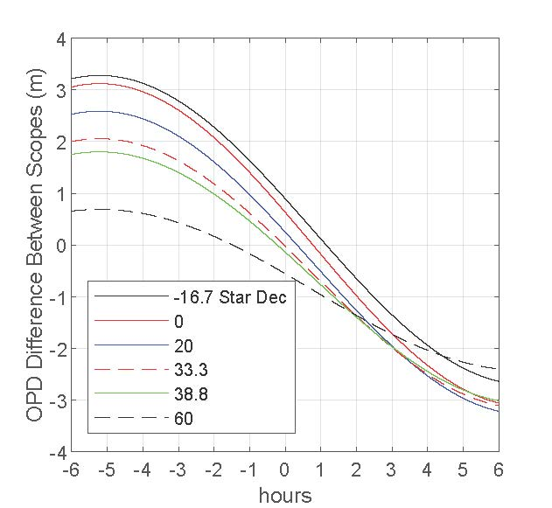
Optical Path Delay vs Hour Angle

Slide 24
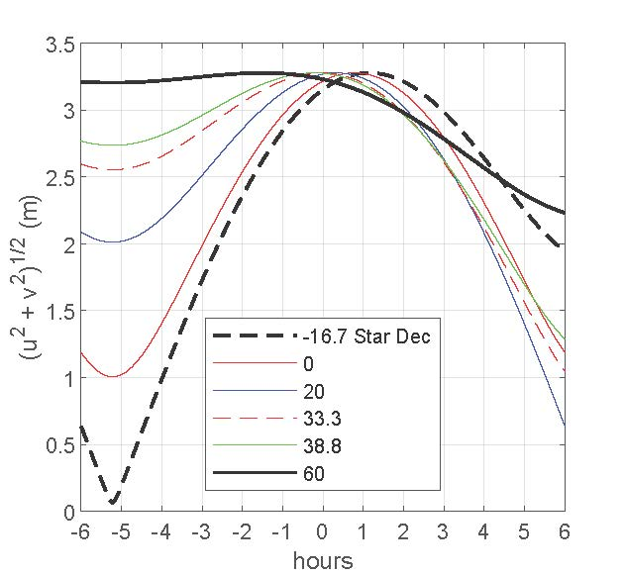
Sirius Baseline Variations vs Hour Angle

Slide 25
Signal Build up
After 1 hr
After first night (4 ¼ h)
After two days (9 h)
After three days (13 ½ h)

Slide 26
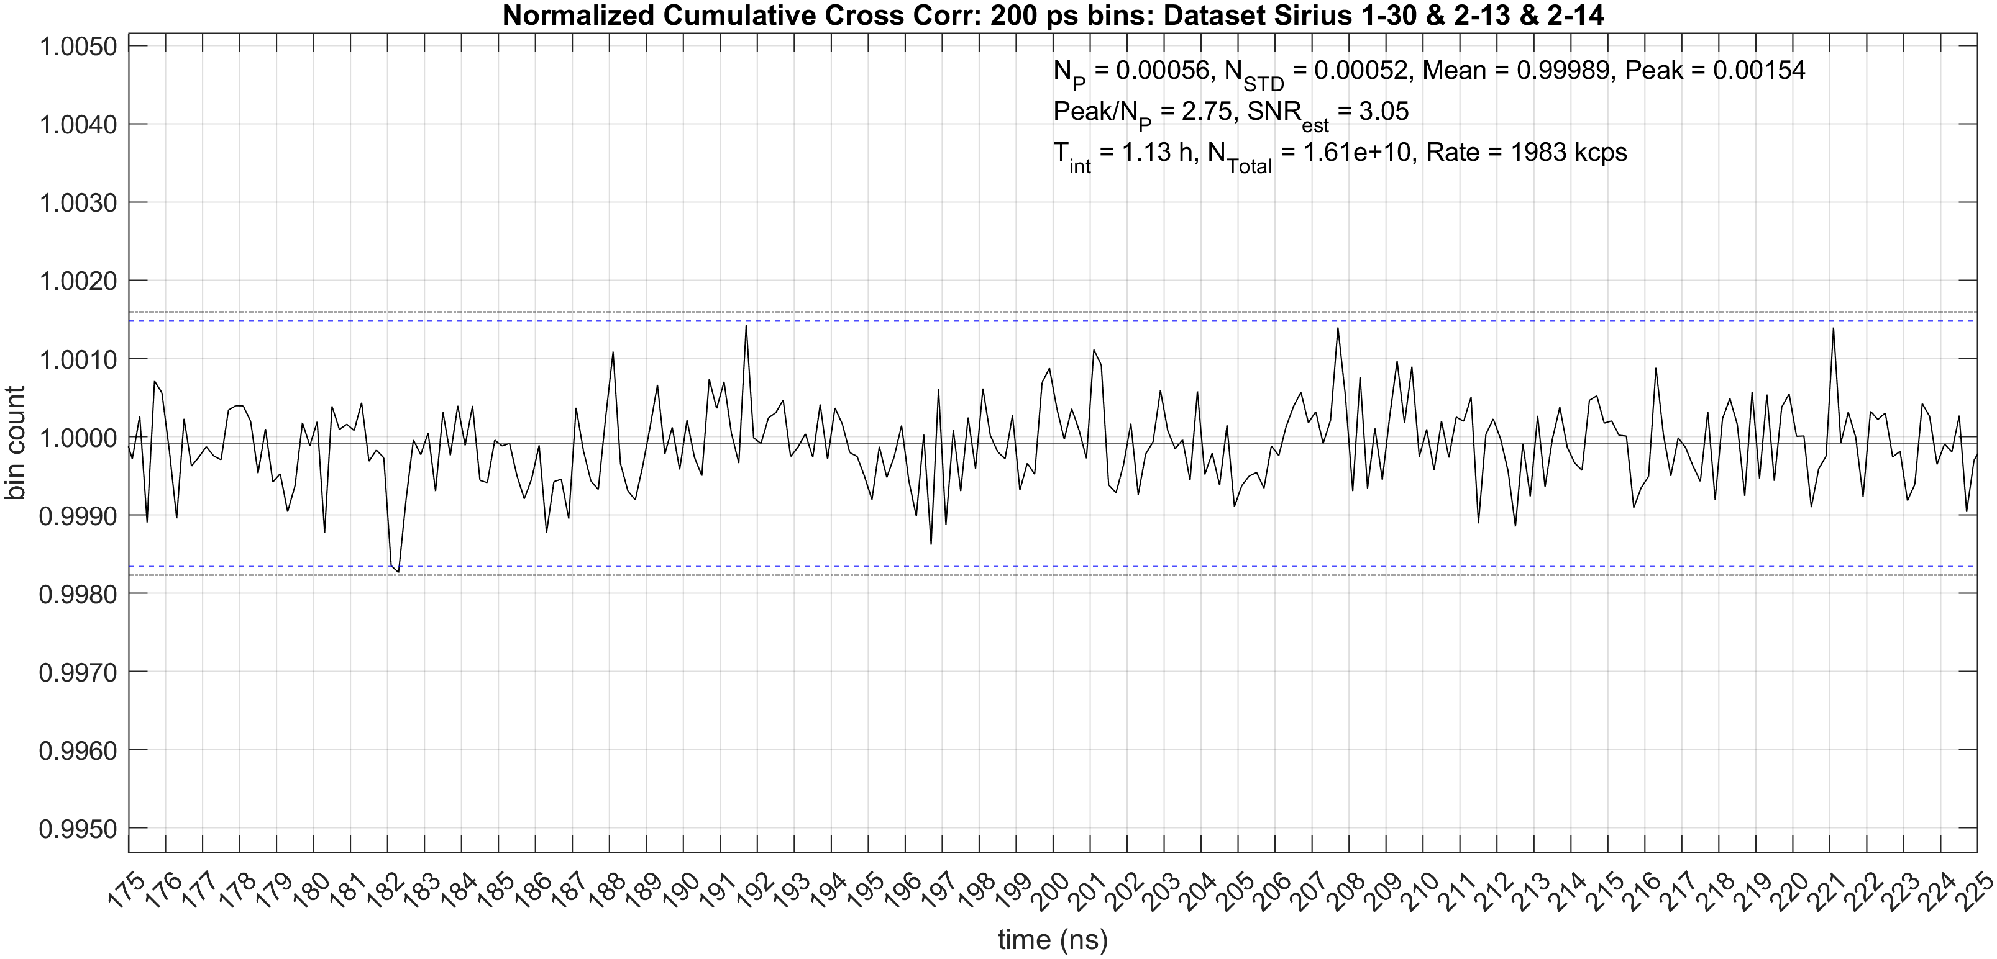
Sirius
Cumulative Results – hour by hour

Slide 27
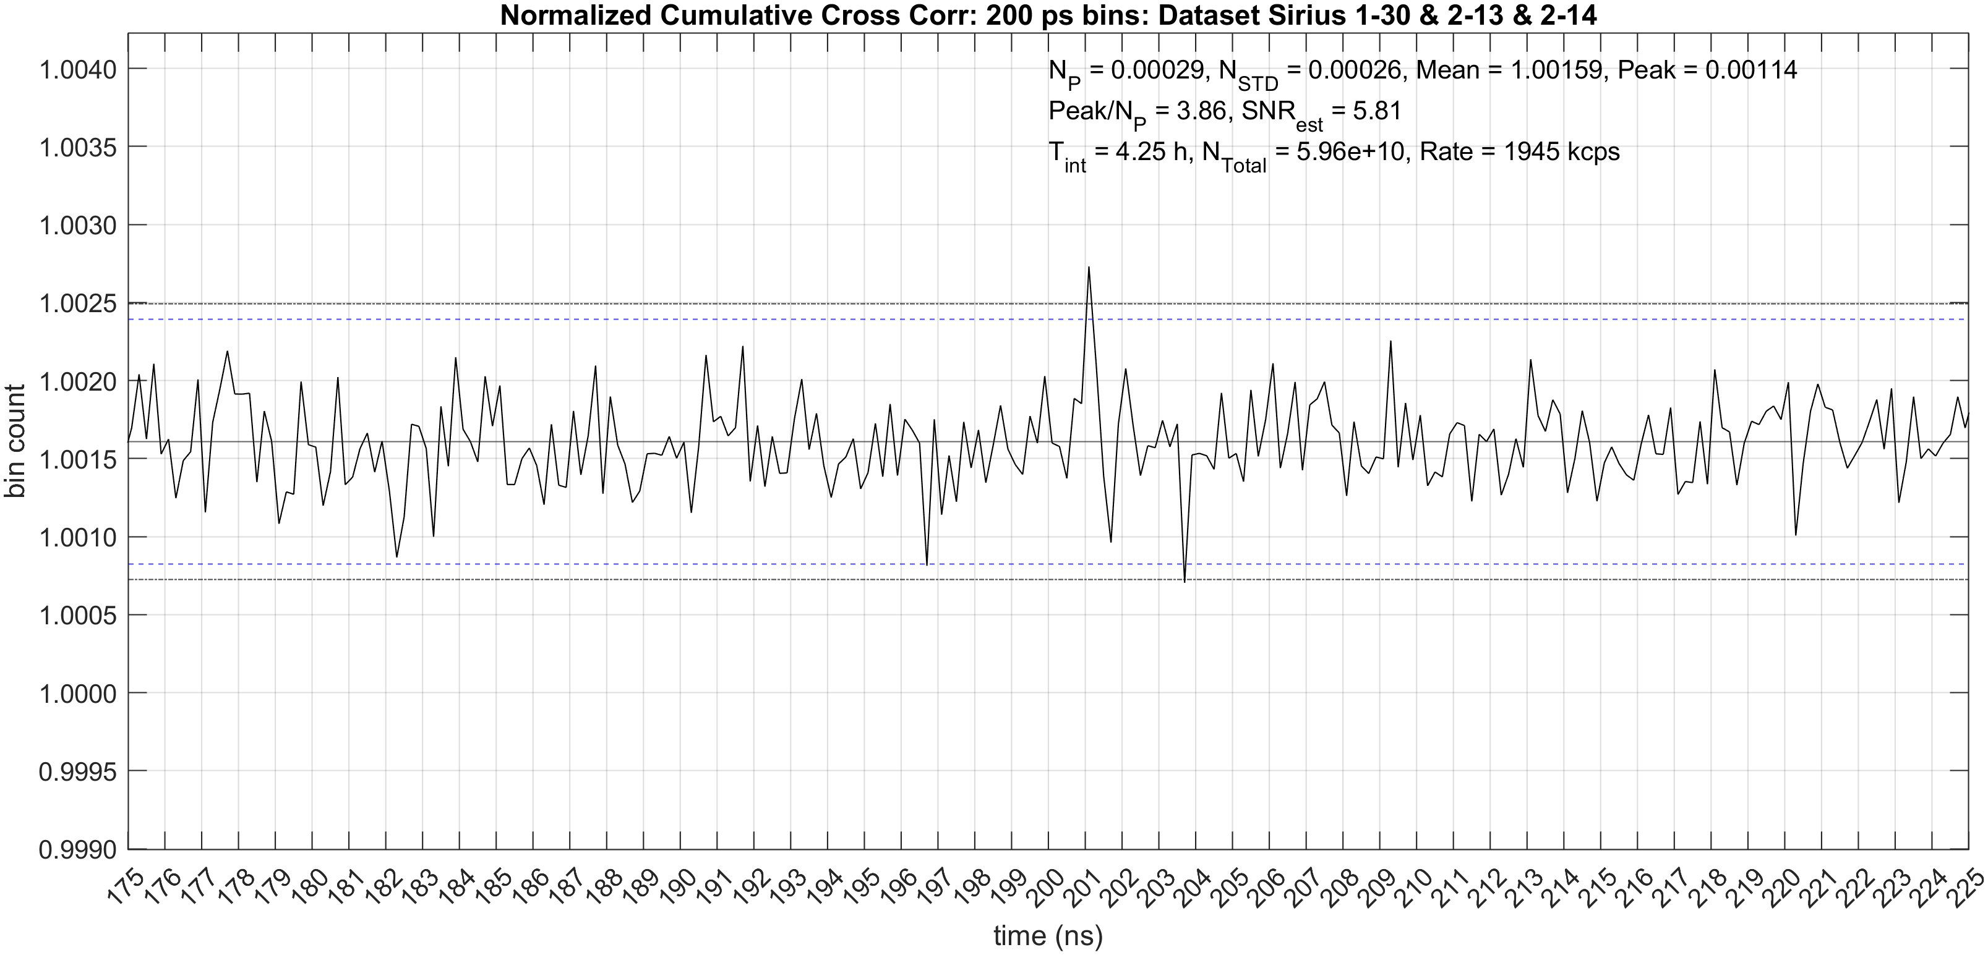

Slide 28
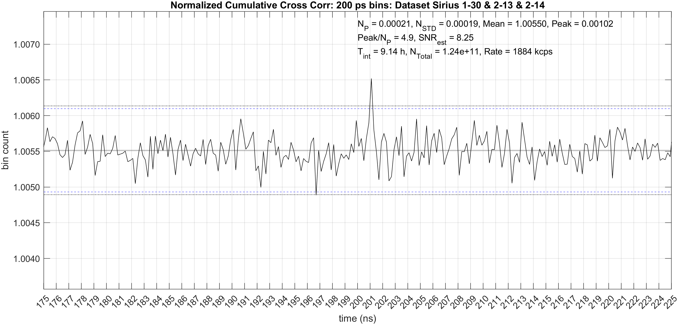

Slide 29
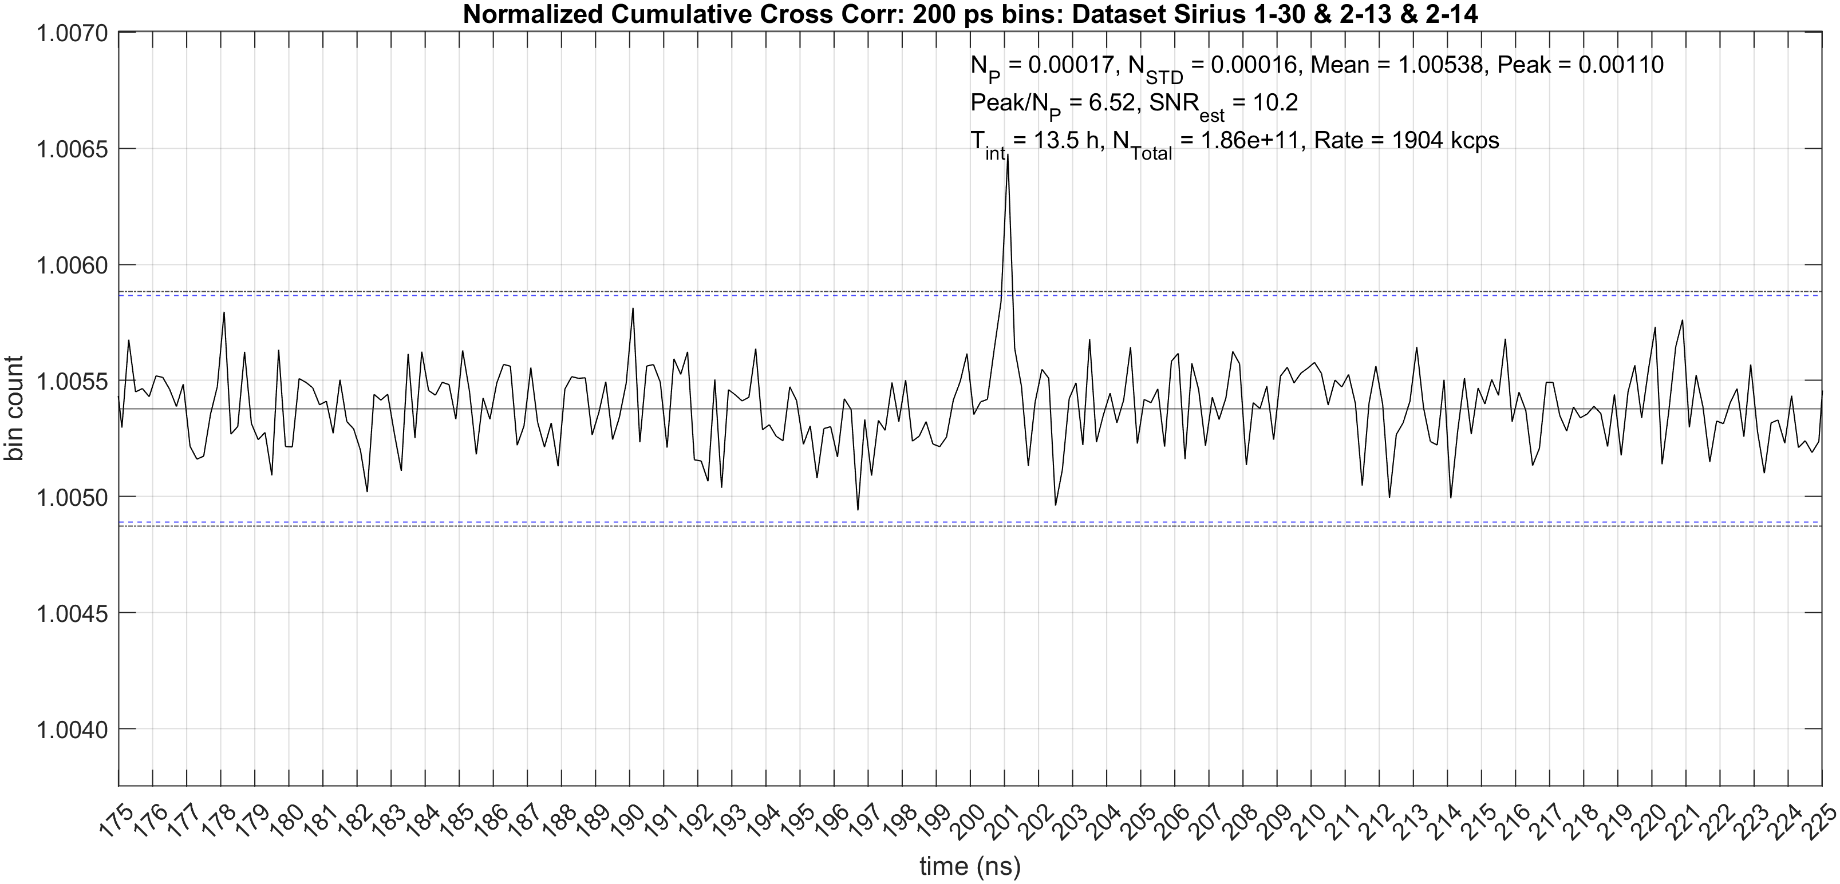

Slide 30
Three Nights – various bin sizes
25 ps bins
50 ps bins
100 ps bins
200 ps bins
250 ps bins
500 ps bins
1000 ps bins

