Slide 1
Atmospheric Scintillation Light & Light Bucket Astronomy
Dave Kieda
U of Utah
11/1/2024
Perimeter Institute

Slide 2
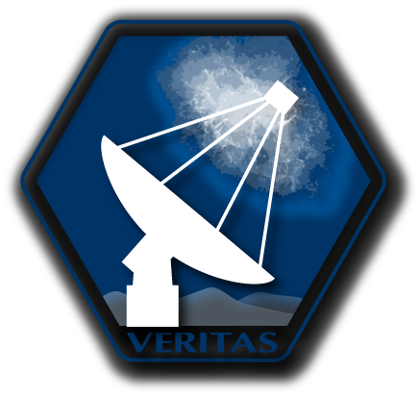
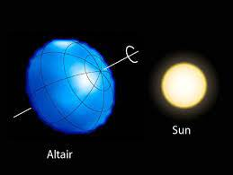
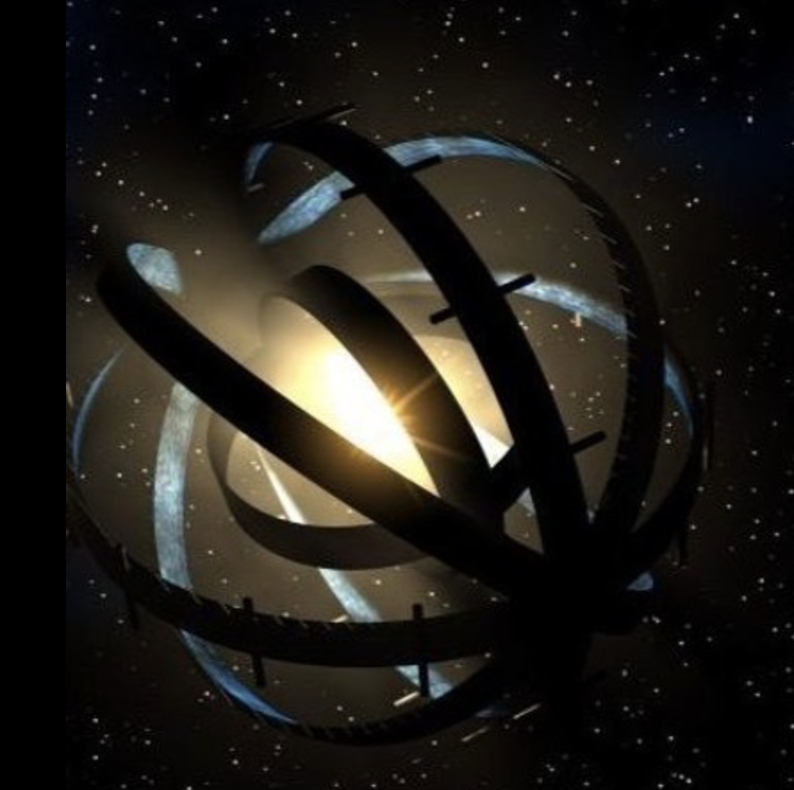
Light Bucket Optical Astronomy: non-imaging Science
1-D/2-D
Measurements of
Stellar dimensions
Stellar Intensity Interferometry
Asteroid occultations
Optical SETI:
Techno-signatures
Dyson Sphere?
Sub-km Kuiper Belt Objects
KBO’s
2

Slide 3
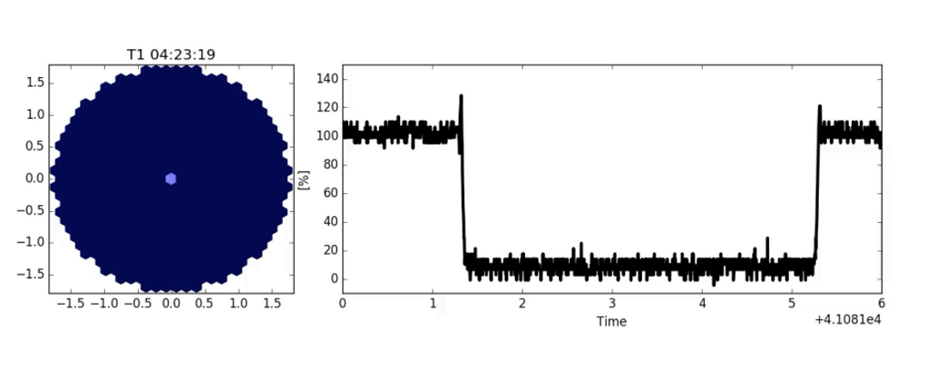
Asteroid Occultations in VERITAS camera
Monitor light level from star (1 pixel)
Fringes = stellar diameter
Asteroid diameter

Slide 4
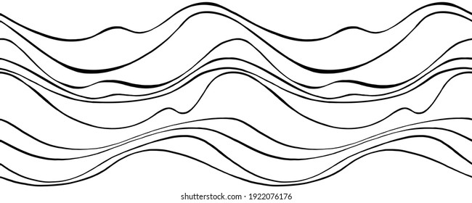
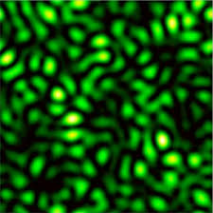
Synopsis of Atmospheric Scintillation
Star
Turbulent atmosphere
Mirror Speckle Pattern

Slide 5
Speckle Pattern & Mirror diameters
vs
Size of speckle vs mirror size. ---depends on wavelength
Ratio of volume to perimeter ---depends upon mirror area

Slide 6
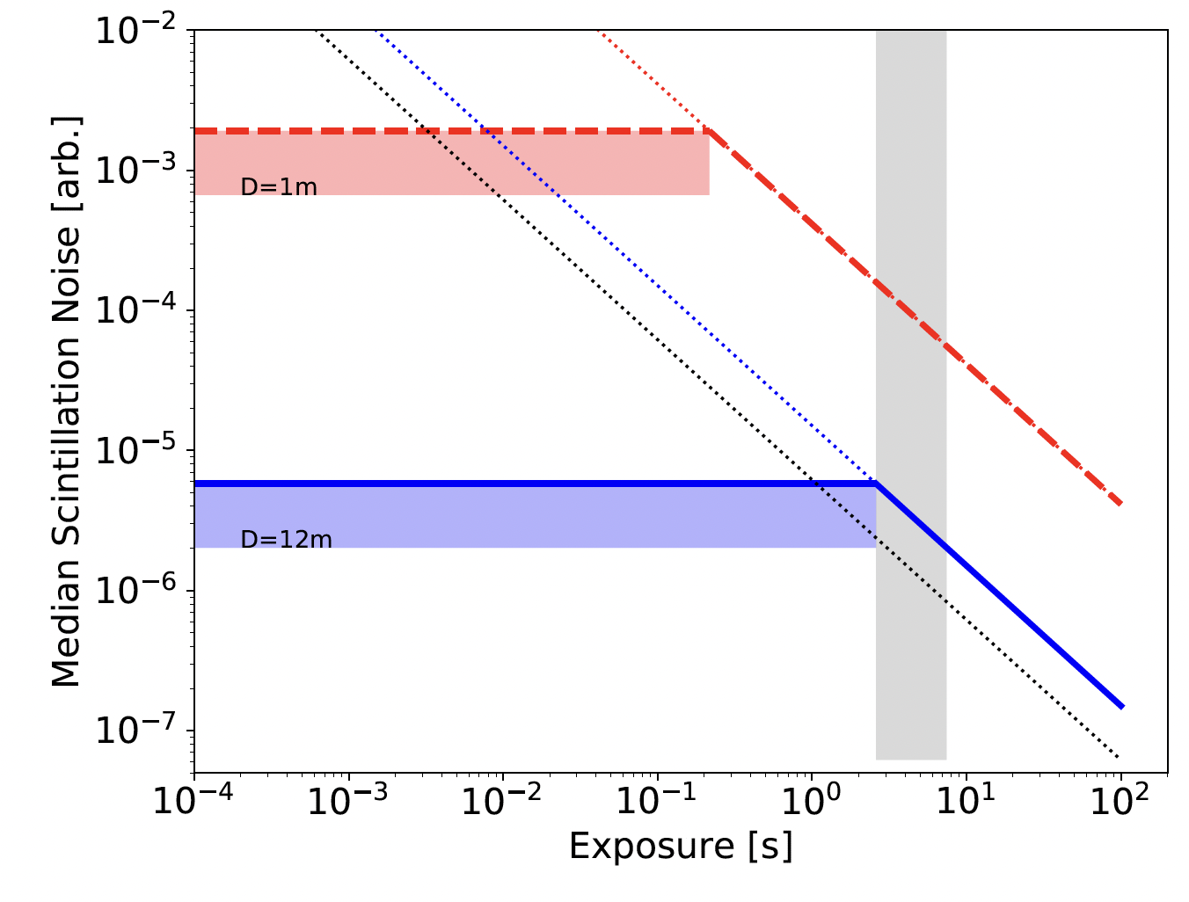
Scintillation Noise and Mirror Area
A well established noise issue
Based upon observed Scintillation Scaling Laws from
Astronomical telescopes
Noise uncertainties
e.g. depends upon chosen site
Fundamental issue for ‘light bucket’ Astronomy (non-imaging, non-AO)
e.g. asteroid occultations
SII, Adaptive optics……..reduced impact
But part of error budget
M. Daniel
PoS (ICRC2019) 007

