Slide 1
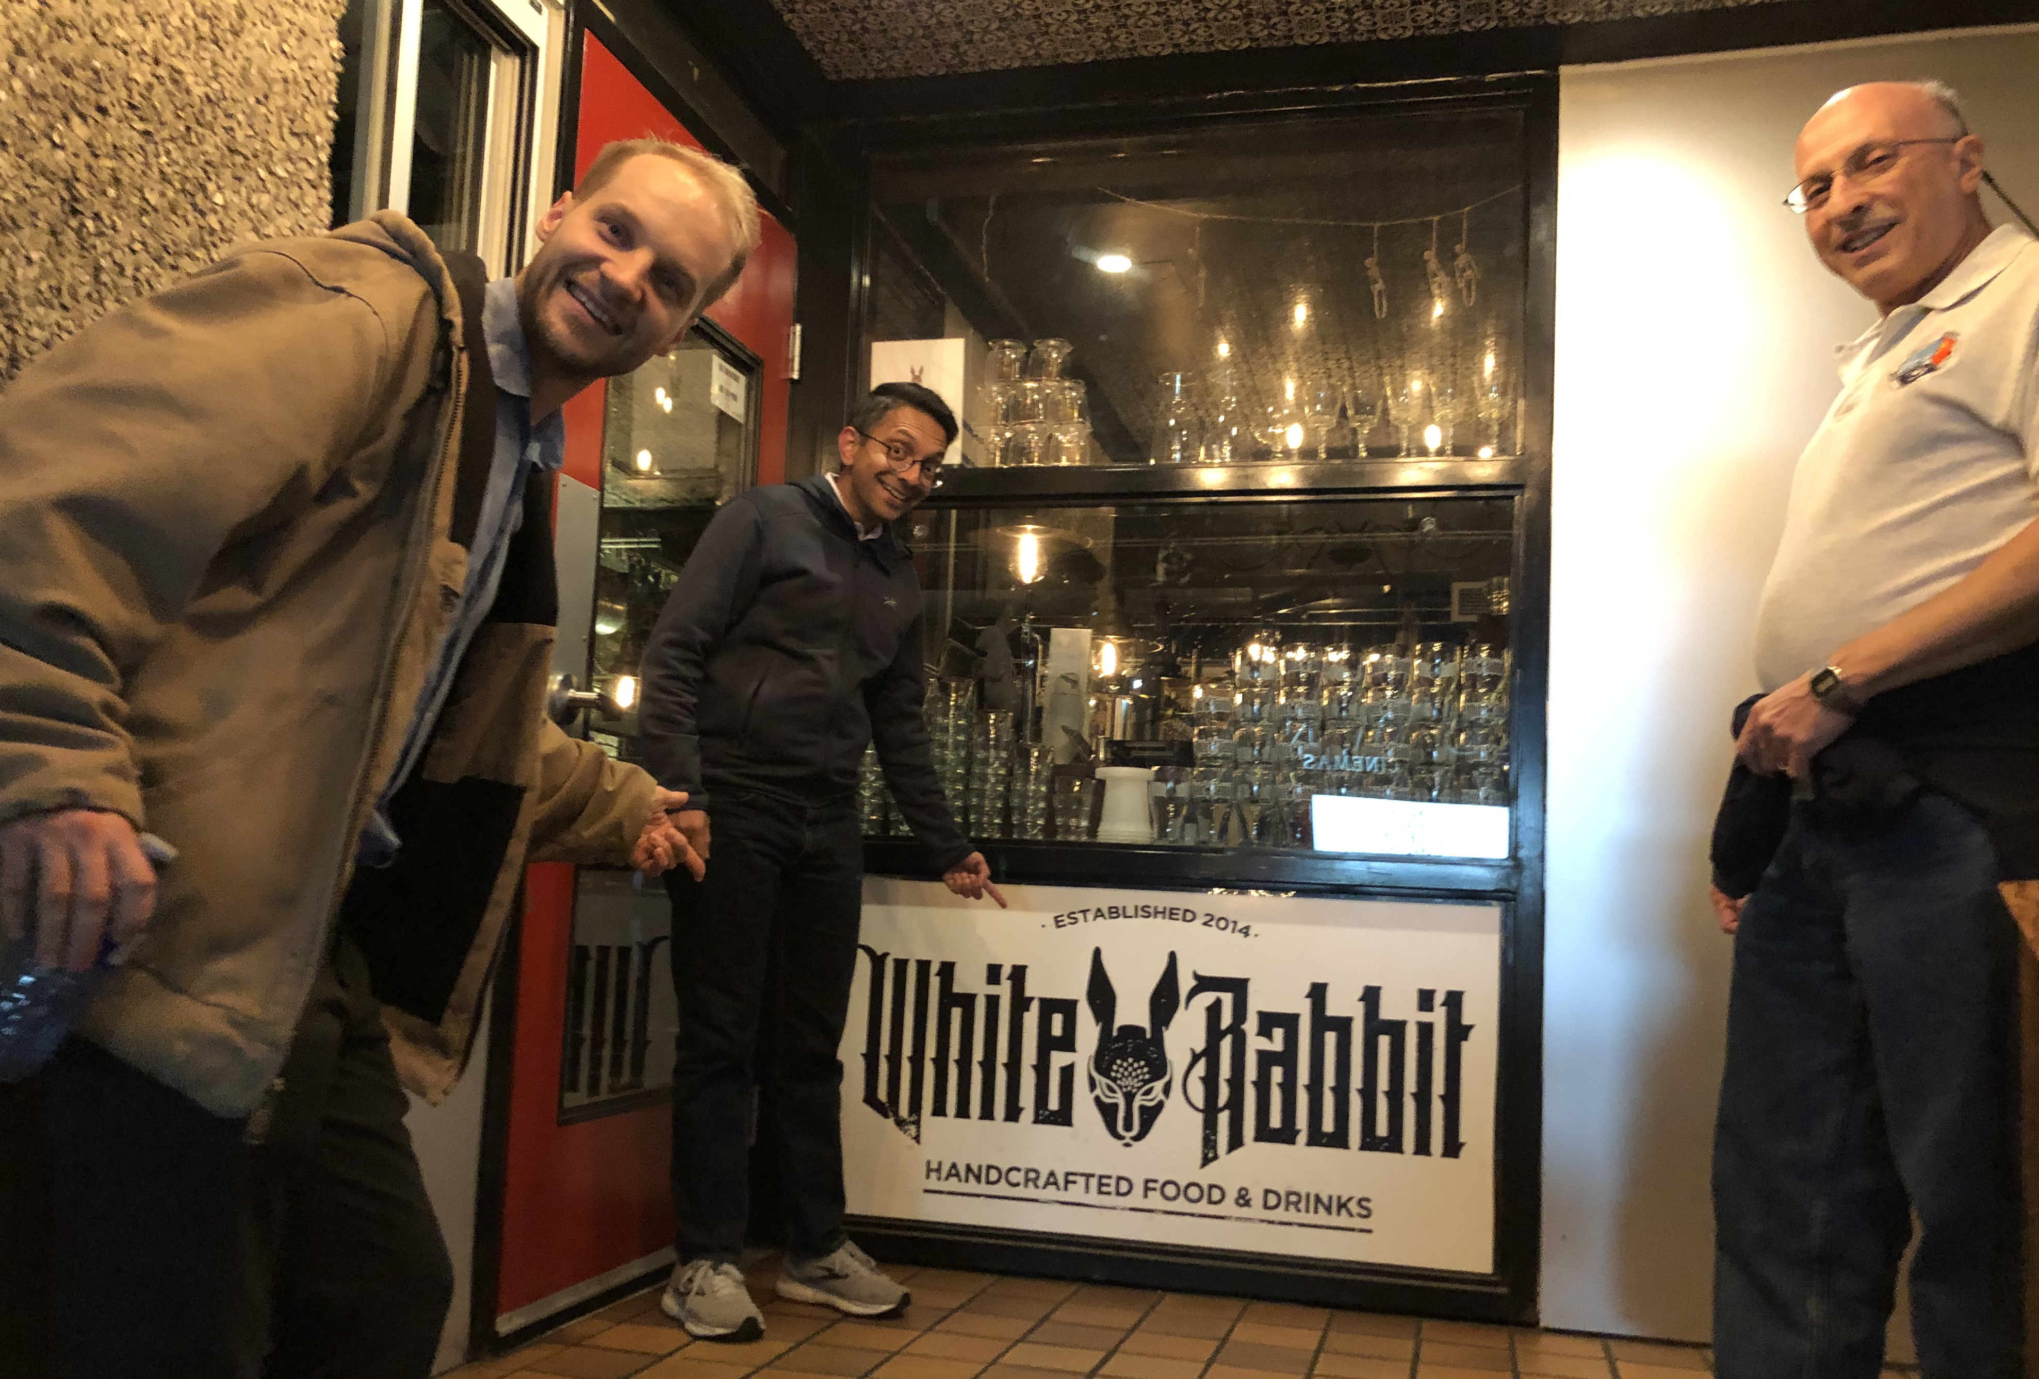
Intensity interferometry science and technology summary and discussion
Philip Mauskopf, ASU
Future Prospects for Intensity Interferometry
Perimeter Institute, November 1, 2024

Slide 2
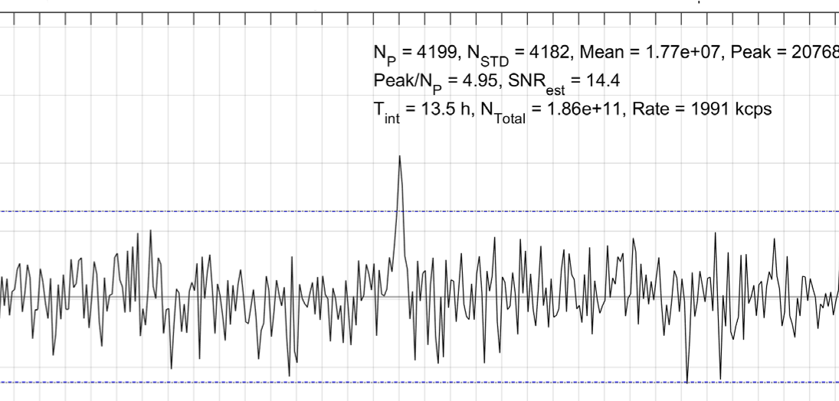
“Heroic” progress over the last decade
Detectors
SPADs - 1 ns —> 10 ps, large format arrays
SNSPDs - 10 um x 10 um —> large detectors, large arrays, 10 ps
Electronics
No commercial products with continuous TDC —> $10k TDC with 8 channels and < 8 ps jitter, integrated TDCs in CMOS with arrays, etc.
On-sky and lab demonstrations
Lots of groups detecting visibilities
“Heroic” because mostly done on the side with few resources

Slide 3
Science with Intensity Interferometry:
Is there a single “primary” science case, e.g. EHT-type case?
Binary supermassive black hole detection/imaging?
Astrometry/dark matter, gravitational waves?
Is this a general facility with lots of science cases, e.g. HST-type?
Can we make a science roadmap - phased approach?

Slide 4
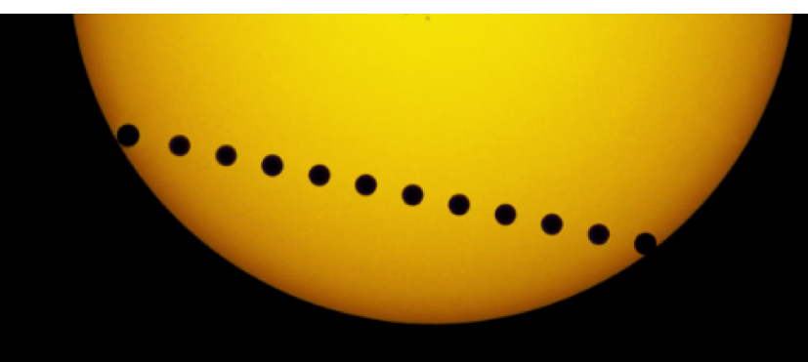
Science with Intensity Interferometry:
Measure WD diameters directly
Exoplanet detection/characterization
Astrometry - planets around Alpha Centauri
RV corrections - images of stellar surfaces
Image galactic BH-star binaries, CV – movies
SS Cygni
Cygnus X-1
Image Supermassive black hole accretion disks
Quasars/AGN
Binary supermassive black holes
Measure/monitor stellar diameters
See cepheid oscillations
Red giant diameter variations – Betelguese
Measure supernova angular diameter
Can measure radius for lots of other stars

Slide 5
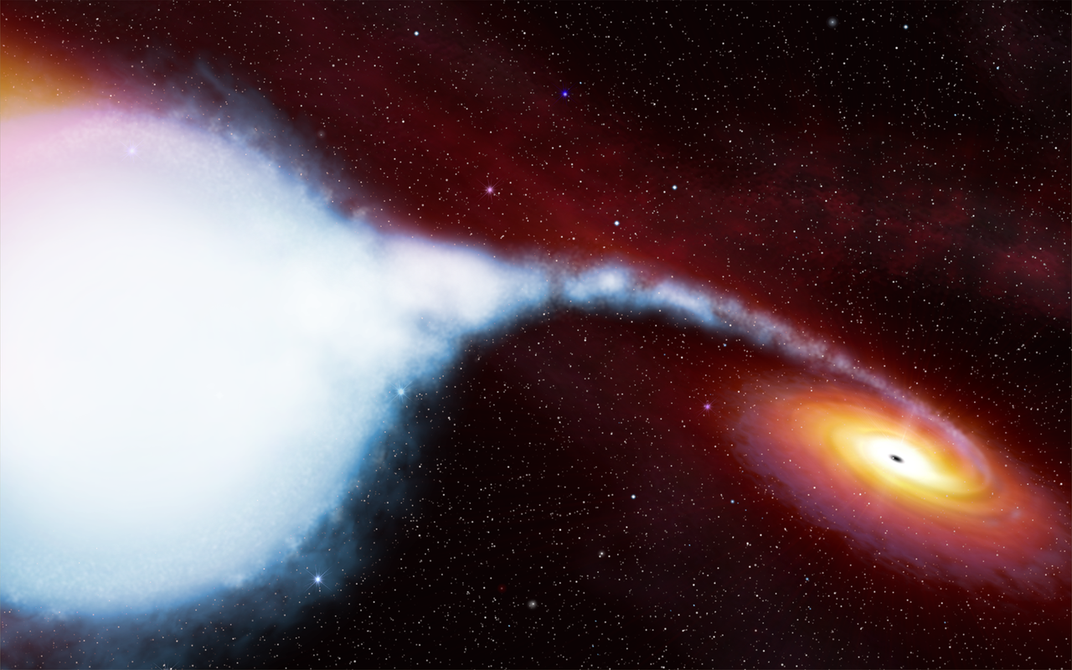
Cygnus X-1
9th magnitude
Black hole – star binary
Orbital period = 5.6 days
Can close phase and make images every few minutes

Slide 6
What are the instrument requirements?
Depends on science case:
Angular resolution: 0.01 - 20 uas
Wavelength range: 400 - 1700 nm
Spectral resolution: R ~ 1-1e6
Sensitivity: Currently > 3 mag —> 8-16 Mag

Slide 7
Different architectures:
Large, low cost apertures - HESS, VERITAS, MAGIC
Advantages/disadvantages/characteristics:
Largest existing optical total aperture
Linear detectors (photomultipliers)
Lots of modes - limits number of wavelength bands?
Can be improved with reimaging optics
Large telescope timing jitter
Can be improved with reimaging optics?
Moderate amount of observation time
Most sensitive current intensity interferometry system

Slide 8
Different architectures:
Large high cost apertures - KECK, CFHT, VLT, ELT, etc.
Advantages/disadvantages/characteristics:
Uses existing telescopes
Good optical performance - few modes
Low telescope timing jitter
Large optical total aperture
Low amount of observation time

Slide 9
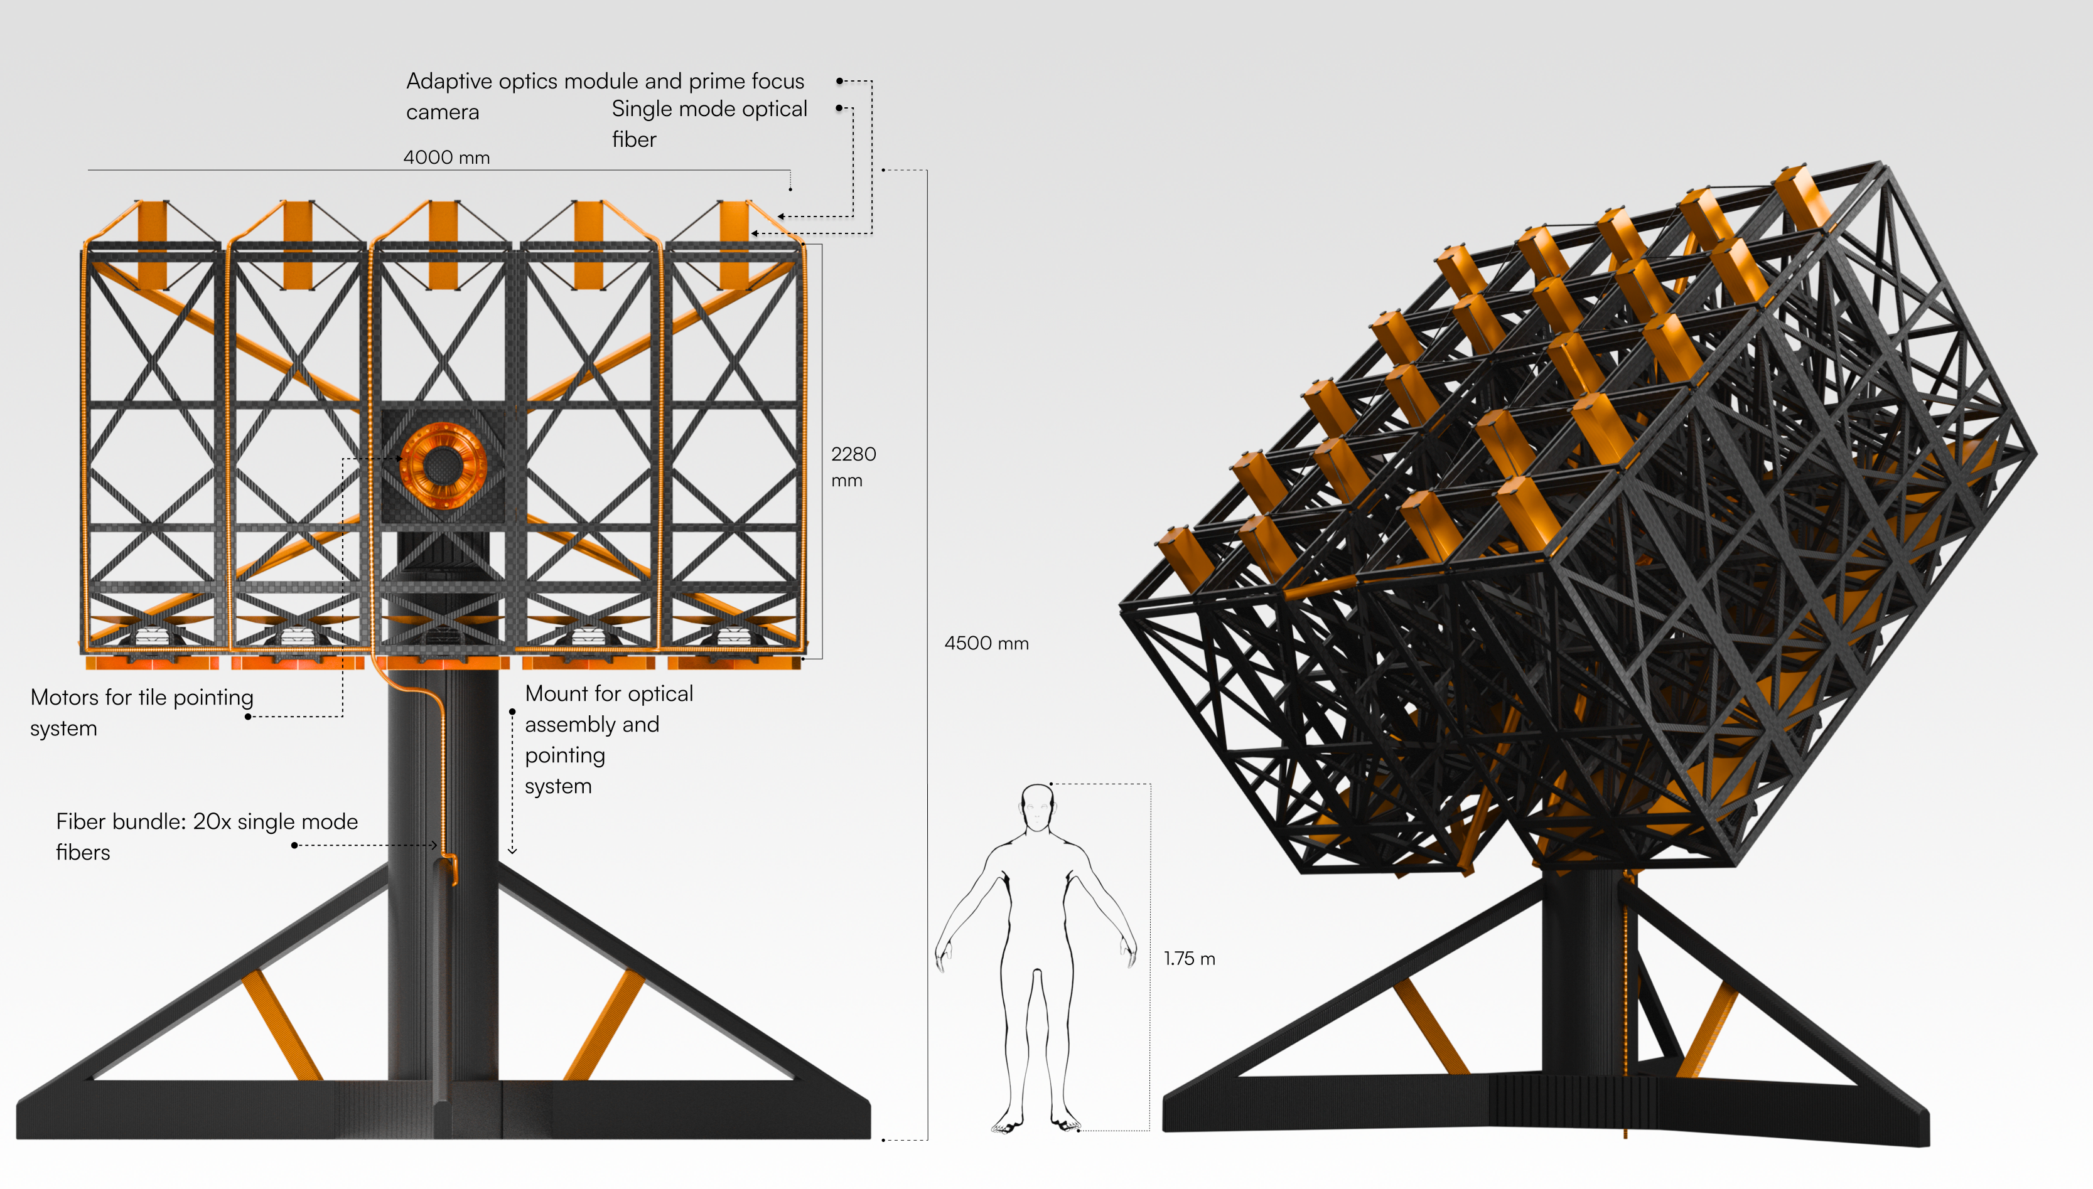
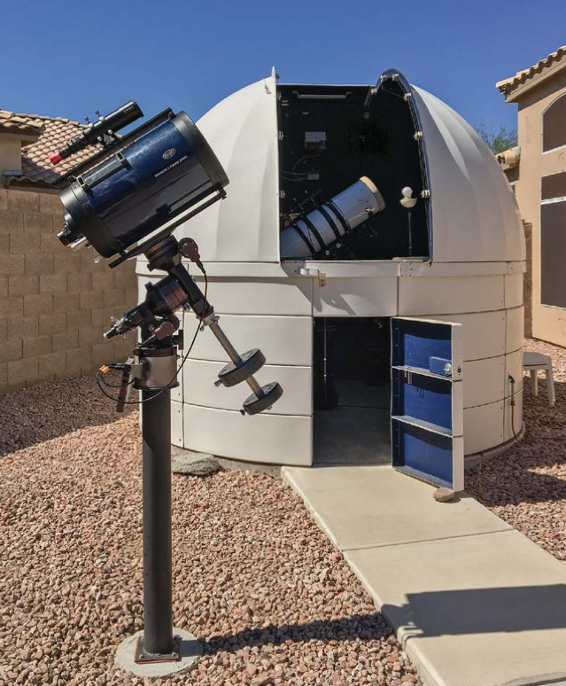
Different architectures:
Small, low cost apertures - SCSI, ASU, LFAST, MAST, etc.
Advantages/disadvantages/characteristics:
Low cost per aperture
Can couple to single mode or few mode fiber
Low telescope timing jitter
Large amount of observation time
Lower limit to source magnitude based on detector dark counts, noise, spectral resolution and scintillation

Slide 10
Technical questions from discussions
Do we need single mode optics/fiber for spectrometer to avoid issues with smearing correlation signals and does it depends on the spectrometer details?
What is the limit to source brightness for small apertures?
Scintillation noise
Detector dark counts (SNSPDs are low)
Guiding
What are the tradeoffs between SNSPDs, SPADs and other detectors (MCP, PMT)?
What are the limits from timing synchronization and atmospheric fluctuations?
How well can we reconstruct images and other source features?

Slide 11
Intensity Interferometry Sensitivity:
Signal to Noise Ratio (SNR) for a visibility
Proportional to count rate divided by bandwidth
Can just add photons from multiple telescopes (all coming from the same point source)
SNR
$$SNR≡\frac{S}{\sqrt{N}}=\frac{{\left(Γ_{1}+Γ_{2}\right)}^{2}}{2Δν\sqrt{Γ_{1}Γ_{2}}}\sqrt{\frac{τ_{int}}{τ_{bin}}}$$
Limiting case ($\overset{¯}{n}≪1$)
$$\frac{S}{\sqrt{N}}=ε\overset{¯}{n}\sqrt{\frac{τ_{int}}{τ_{det}}}=\frac{Γ}{Δν}\sqrt{\frac{τ_{int}}{τ_{det}}}$$
SNR ~ Collecting Area
Larger collecting area = fainter sources can be measured

Slide 12
Intensity Interferometry Sensitivity:
Signal to Noise Ratio (SNR) for a visibility
Proportional to count rate divided by bandwidth
Can just add photons from multiple telescopes (all coming from the same point source)
Scaling: Mag 0 star
2 x 0.25 meter telescopes
0.35 ns time resolution
1 nm bandwidth (SNR is independent of bandwidth)
10 hours for 5 sigma
SNR
$$SNR≡\frac{S}{\sqrt{N}}=\frac{{\left(Γ_{1}+Γ_{2}\right)}^{2}}{2Δν\sqrt{Γ_{1}Γ_{2}}}\sqrt{\frac{τ_{int}}{τ_{bin}}}$$
Limiting case ($\overset{¯}{n}≪1$)
$$\frac{S}{\sqrt{N}}=ε\overset{¯}{n}\sqrt{\frac{τ_{int}}{τ_{det}}}=\frac{Γ}{Δν}\sqrt{\frac{τ_{int}}{τ_{det}}}$$

Slide 13
Intensity Interferometry Sensitivity:
Signal to Noise Ratio (SNR) for a visibility
Proportional to count rate divided by bandwidth
Can just add photons from multiple telescopes (all coming from the same point source)
Scaling: Mag 8 source (1500x)
16 x 0.5 meter telescopes = 64x brightness
20 ps time resolution (4x brightness)
1000 bands (30x brightness)
1 hour for 10 sigma
SNR
$$SNR≡\frac{S}{\sqrt{N}}=\frac{{\left(Γ_{1}+Γ_{2}\right)}^{2}}{2Δν\sqrt{Γ_{1}Γ_{2}}}\sqrt{\frac{τ_{int}}{τ_{bin}}}$$
Limiting case ($\overset{¯}{n}≪1$)
$$\frac{S}{\sqrt{N}}=ε\overset{¯}{n}\sqrt{\frac{τ_{int}}{τ_{det}}}=\frac{Γ}{Δν}\sqrt{\frac{τ_{int}}{τ_{det}}}$$

Slide 14
Intensity Interferometry Sensitivity:
Signal to Noise Ratio (SNR) for a visibility
Proportional to count rate divided by bandwidth
Can just add photons from multiple telescopes (all coming from the same point source)
Scaling: Mag 16 source – factor of 10⁶ in brightness/flux
1000 x 0.8 meter telescopes
(factor of 10000x in area)
20 ps time resolution
(factor of 4 in SNR)
1000 bands (factor of 30 in SNR)
1 hour for 10 sigma
SNR
$$SNR≡\frac{S}{\sqrt{N}}=\frac{{\left(Γ_{1}+Γ_{2}\right)}^{2}}{2Δν\sqrt{Γ_{1}Γ_{2}}}\sqrt{\frac{τ_{int}}{τ_{bin}}}$$
Limiting case ($\overset{¯}{n}≪1$)
$$\frac{S}{\sqrt{N}}=ε\overset{¯}{n}\sqrt{\frac{τ_{int}}{τ_{det}}}=\frac{Γ}{Δν}\sqrt{\frac{τ_{int}}{τ_{det}}}$$

Slide 15
Comparison with Amplitude Interferometry
Why intensity interferometry instead of amplitude interferometry?
Angular resolution!
Sensitivity vs. cost?
VLTI - limiting K magnitude ~ 14 (1 ms integration) (lower with reference star in FOV) - 100 meters
MPOI - limiting J, H, K magnitude ~ 12
CHARA - limiting magnitude ~ 8-10
BFT - limiting magnitude - 6-8

Slide 16
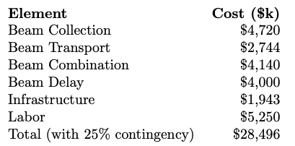
BFT: Van Belle and Jorgensen
Optimal imaging of targets with angular sizes 0.40 to 0.60 mas (with imaging possible outside this range)
Visible light sensitivity (I-band, 790nm) of 7.6 - 8.0 mag (requirement / goal) (3 seconds integration time)
Near-infrared sensitivity (H-band, 1550nm) of 5.6 - 6.0 mag (requirement / goal)
Resolving power of 0.20 - 0.90 μas (Michelson vs. Airy criteria - eg. 0.25 λ / B vs. 1.22 λ / B, ‘modeling’ versus ‘true imaging’), which will enable surface characterization at the 10 × 10 to 30 × 30 pixel level for 0.40 to 0.60 mas targets, which is expected to be sufficient for detecting and monitoring magneto- hydrodynamically controlled processes manifesting on the stellar surface [14].
$28.5M

Slide 17
BFT: Intensity interferometry
Assume same telescopes coupled to single mode fibers
R - 1000 spectrographs with 1000 x 16 detectors
Magnitude limit (SNR = 10 in 1 hour) ~ 8
Beam collection: $4.7M (same)
Spectrometer and detectors: $4M (unique)
Infrastructure and manpower: $2-6M (less)
$10-15M

Slide 18
Thanks to Perimeter and
Next steps
White paper(s) from this workshop
Science book
Technology overview and roadmap
Funded activities in Europe
Proposals in US/Canada/etc.
Next observational steps - multi wavelength on sky measurements, multiple telescopes, etc.
Next theoretical steps - refine science/cases and technical requirements

Slide 19
SII 2025
Meeting in Fraunhofer Society in Waischenfeld in Franconia, located about 50 km from Erlangen (1h drive by car, 1,5h by bus)
https://www.iis.fraunhofer.de/de/profil/standorte/forschungscampus-waischenfeld.html

